Slide 1
Art Bible
Project Sleuth

Slide 2
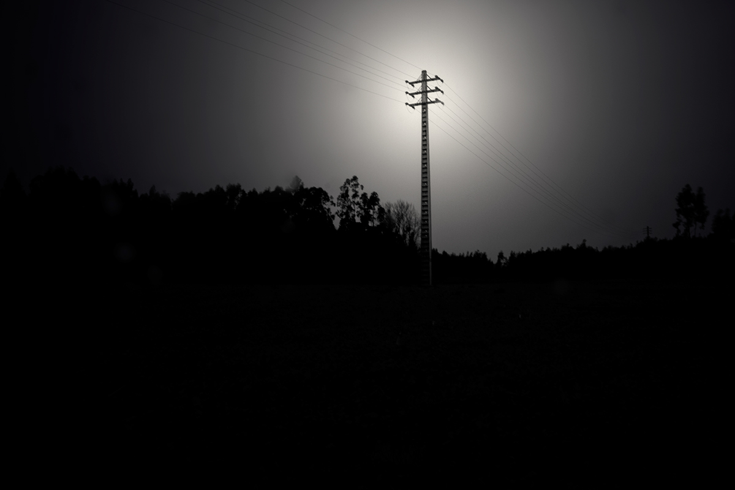
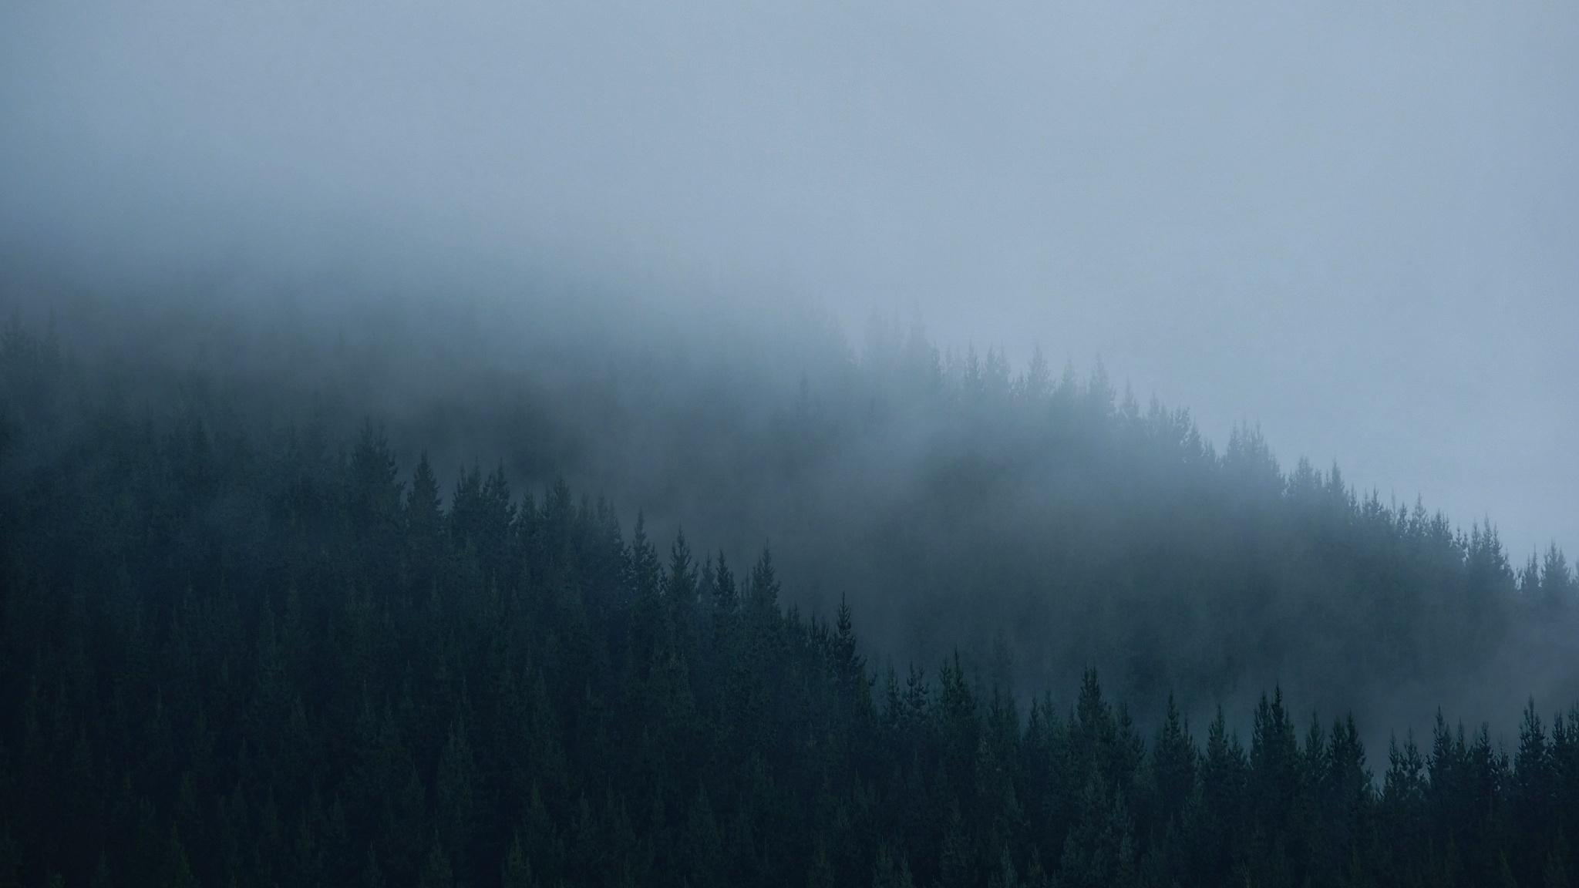
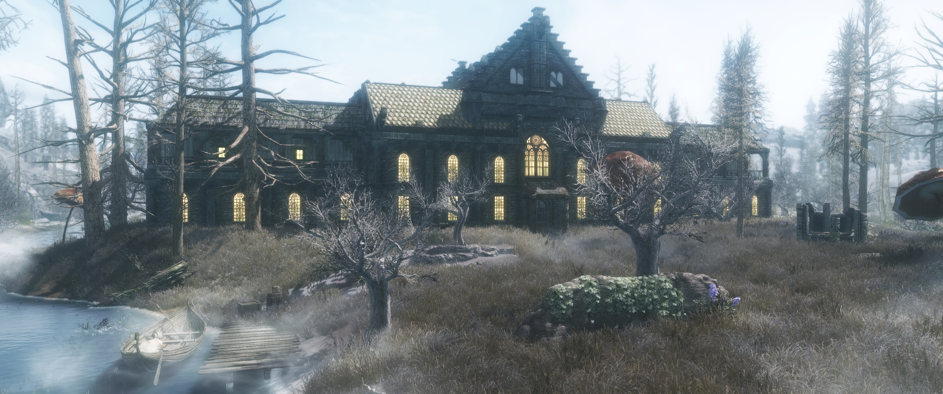
Mood and vibe
Light is amplified in the large amount of darkness
Using these two images give off a grim setting.
Foggy settings causing more difficulty
for sight also gives off a creepy vibe.
Primary feeling being a sense of evil.

Slide 3

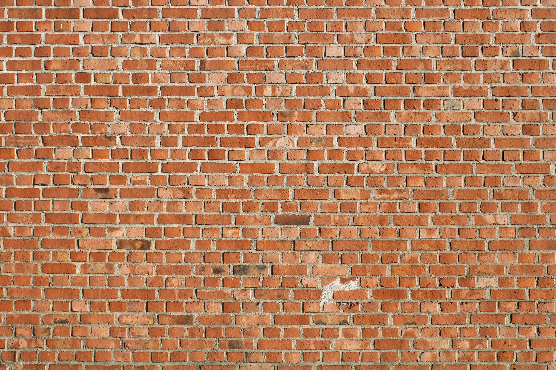
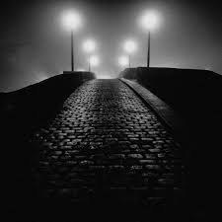
Project Art Style
2000x2000 Texture size
Photo-realistic style over all.
High quality
Foggy, Obstructed light sources
Obstructed moon giving little light

Slide 4
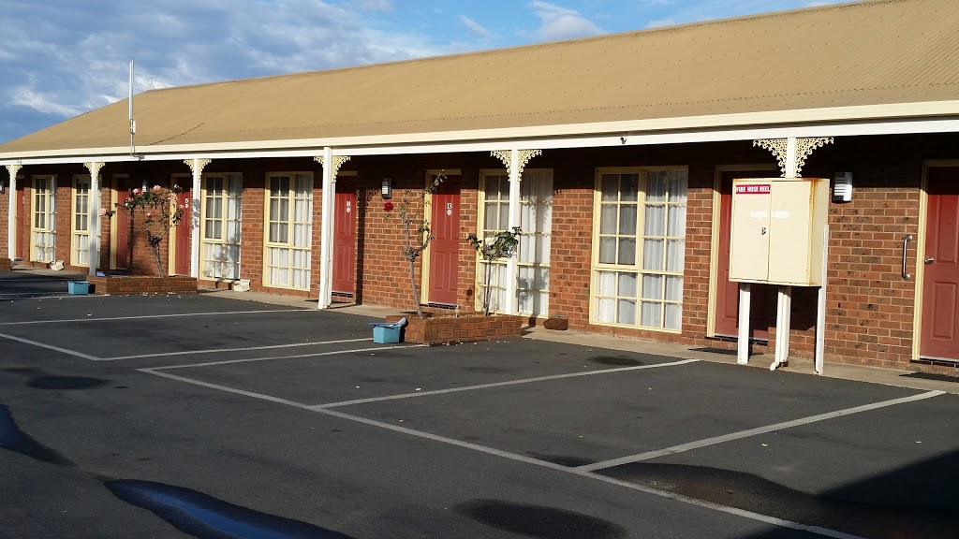
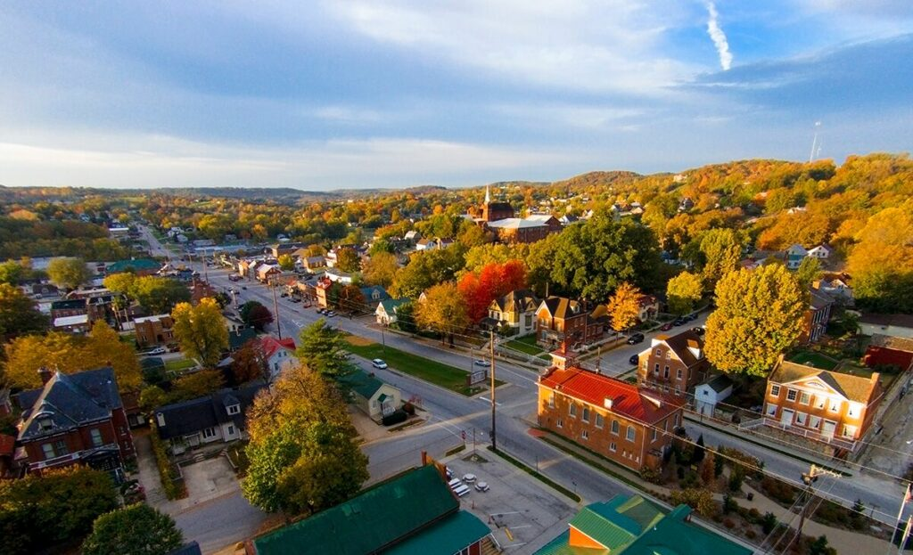
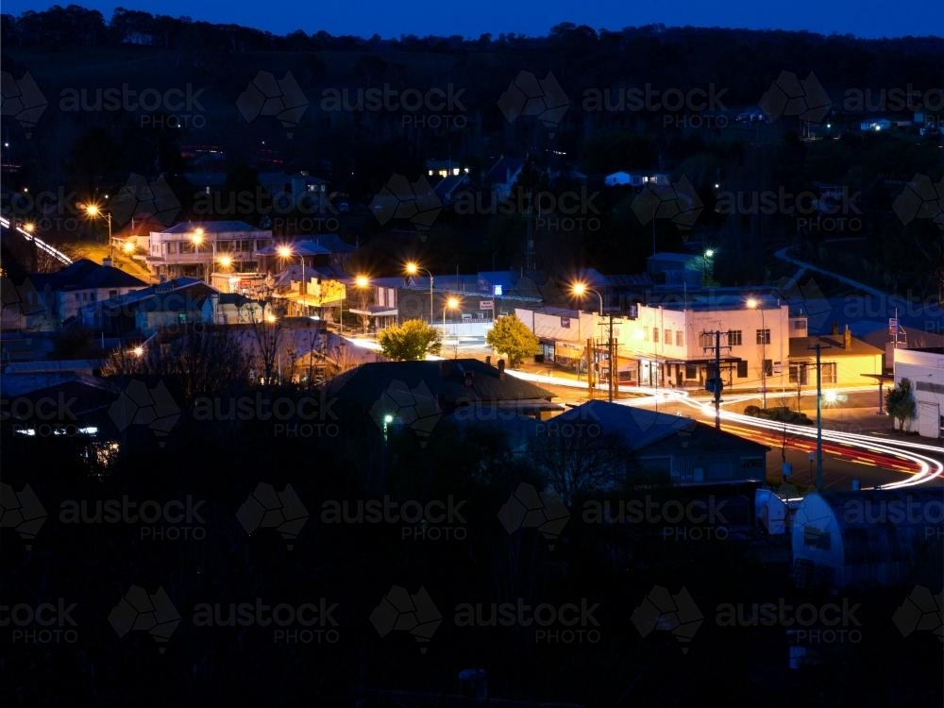
Environment
Motel
Rural Small Town
Night

Slide 5
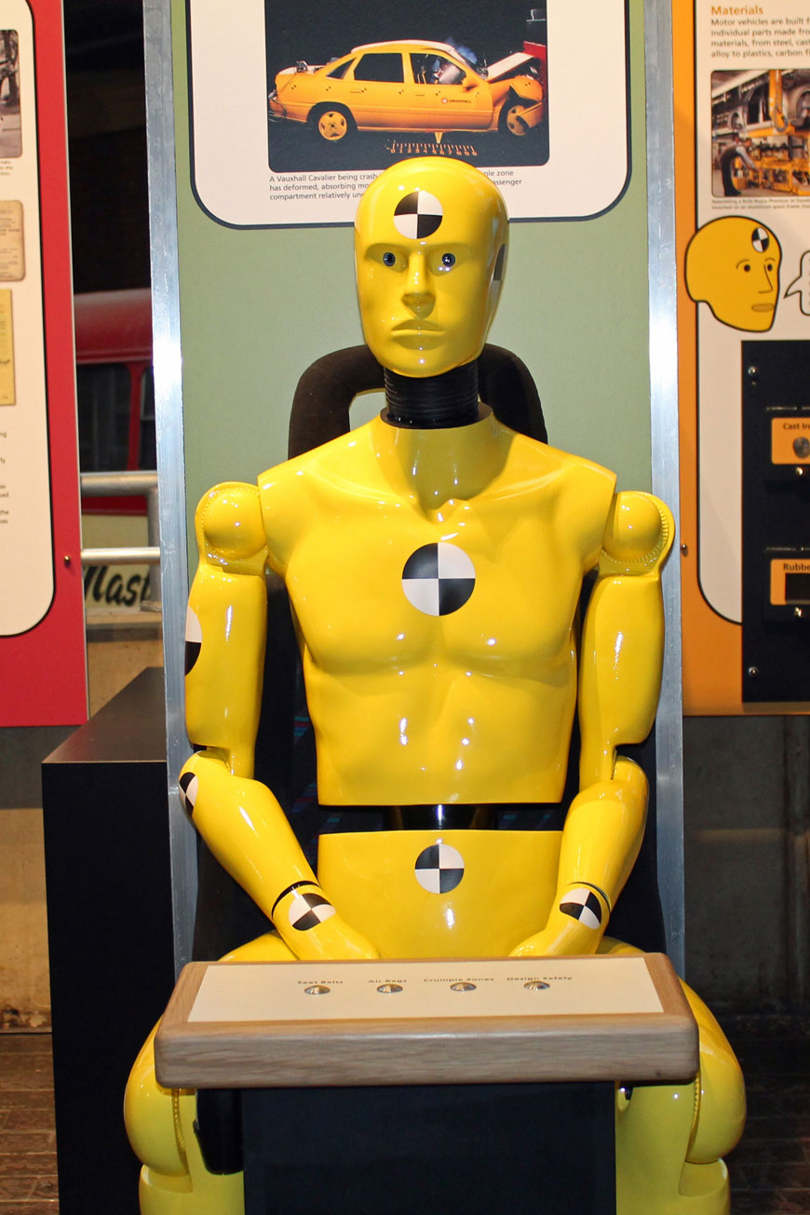
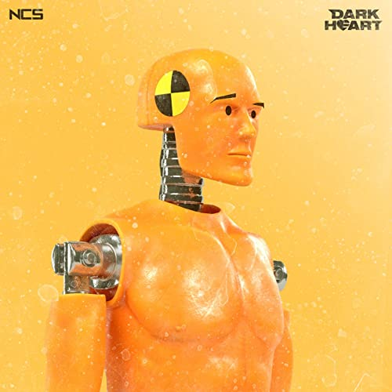
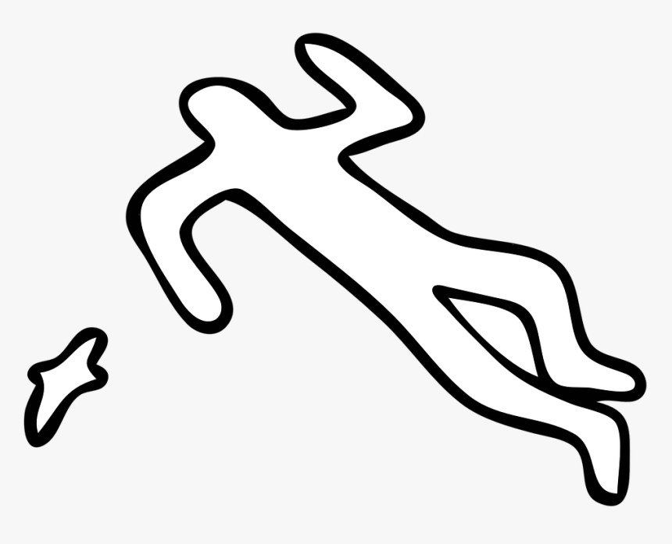
Characters
Humanoid dummy
Outline of humanoid dummy

Slide 6
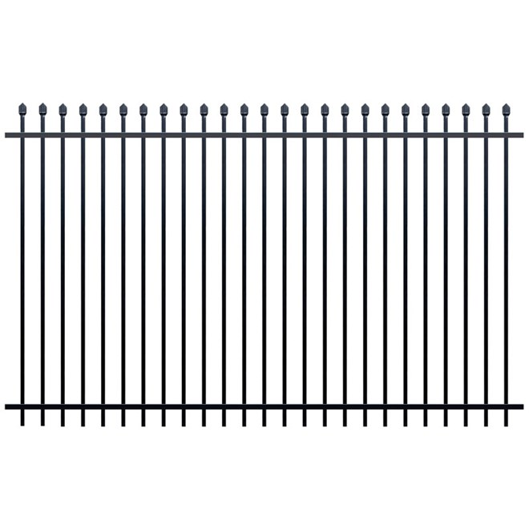
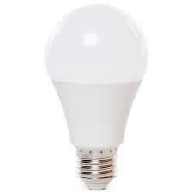
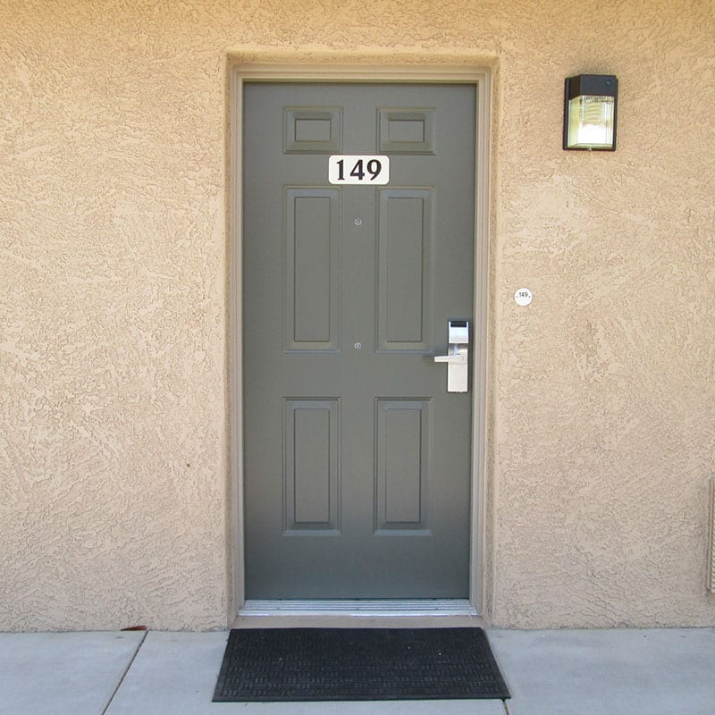
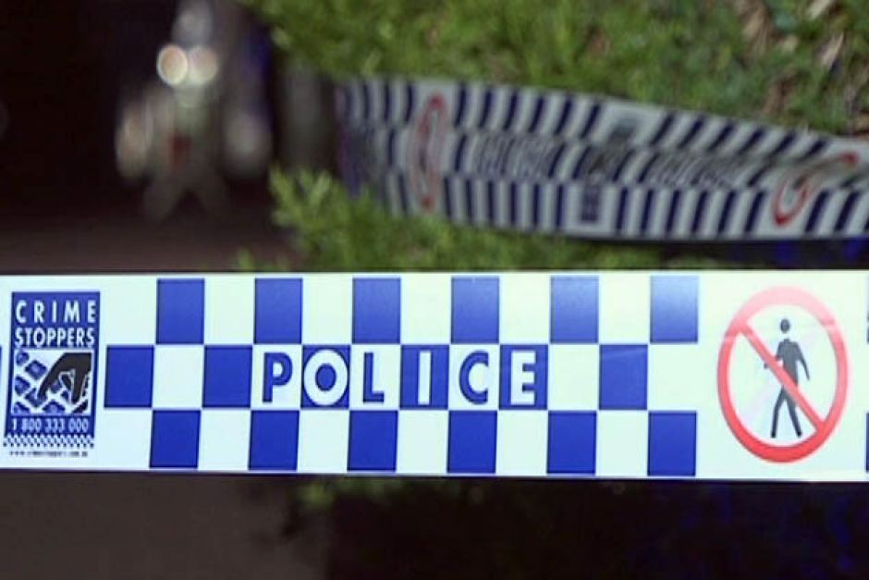
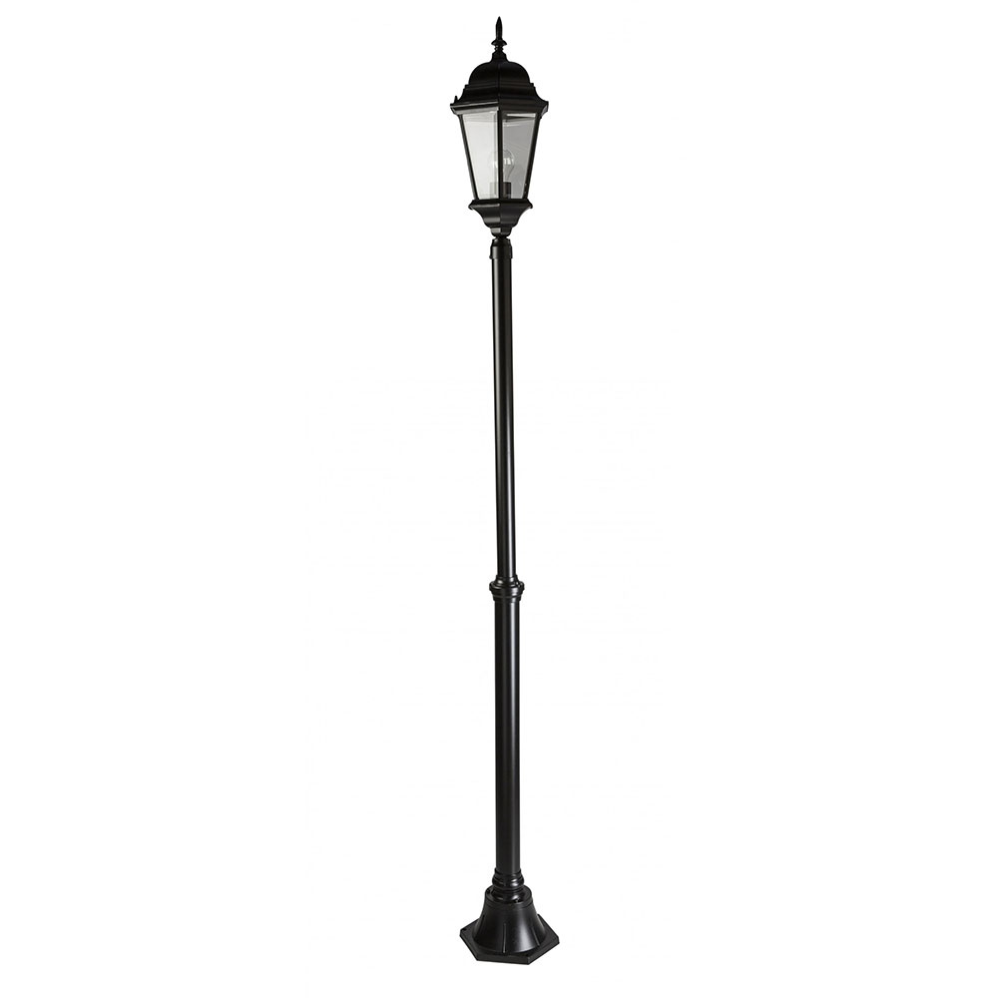
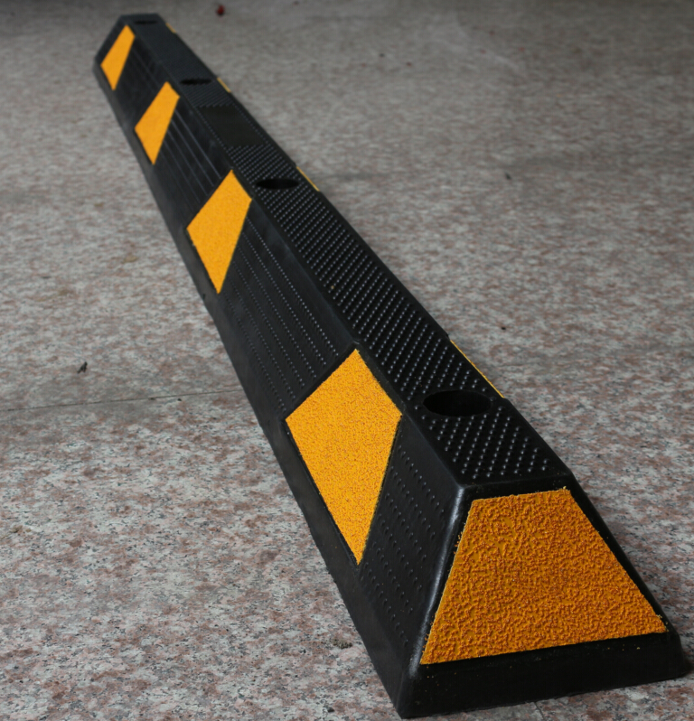
Models
Light Bulb
Fence
Door
Police tape
Light pole
Car Stopper
Police van

Slide 7
Textures

Slide 8
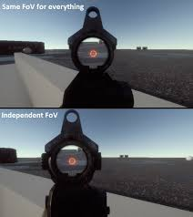
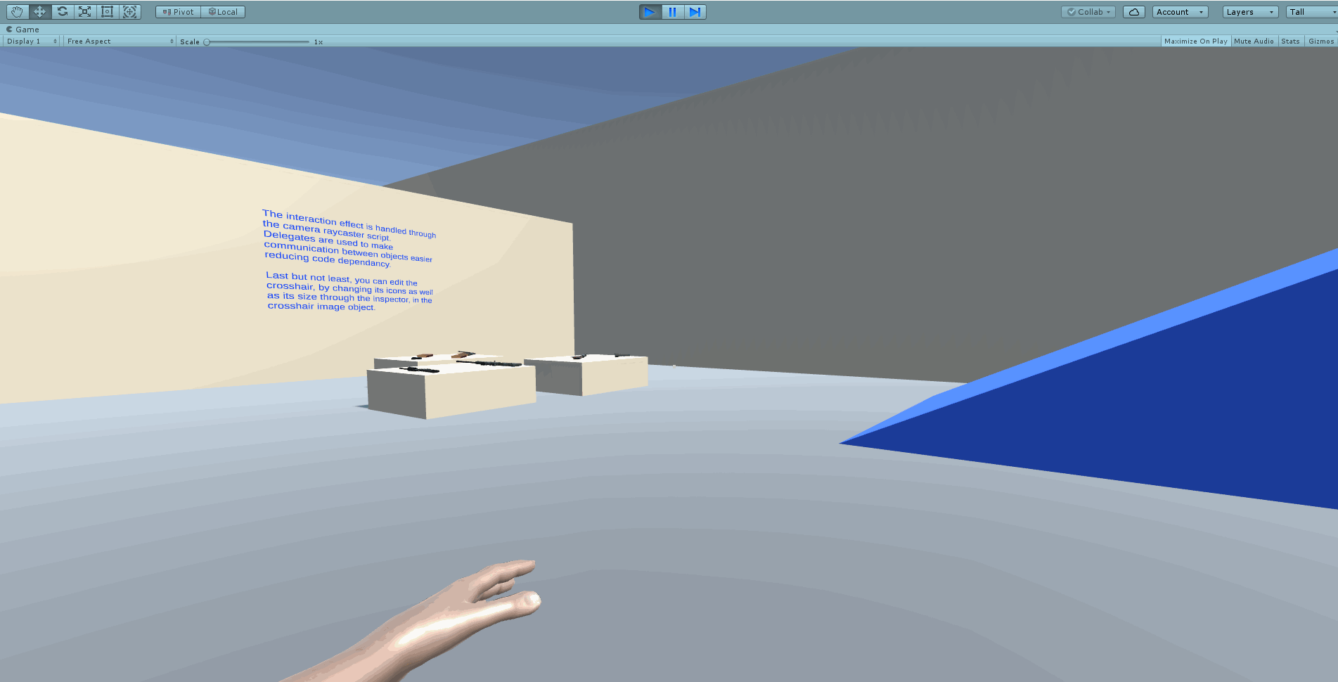
Camera
No guns just showing first person
First person

Slide 9
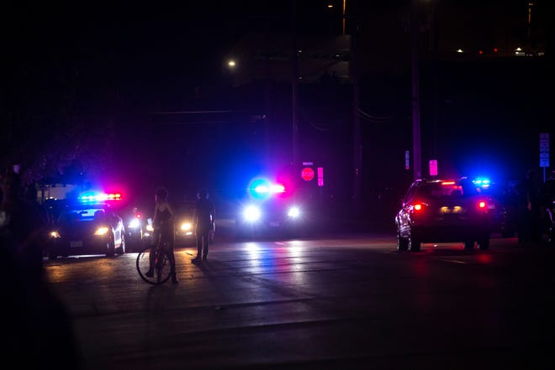
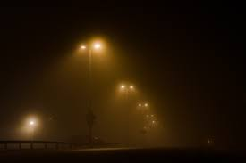
Lighting
Hyper bright police lights
Moon hidden but giving a little light
Fog causing this lighting effect

Slide 11
Level of detail

Slide 12
UI Style

